Slide 1
Arduino Ide ilovasini o’rnatish
1. Arduino ide ilovasini yuklab olish va o’rnatish.
2. ch340g usb driverni yuklab olish.
3. Arduino usb – interface bilan bog’lanish.

Slide 2
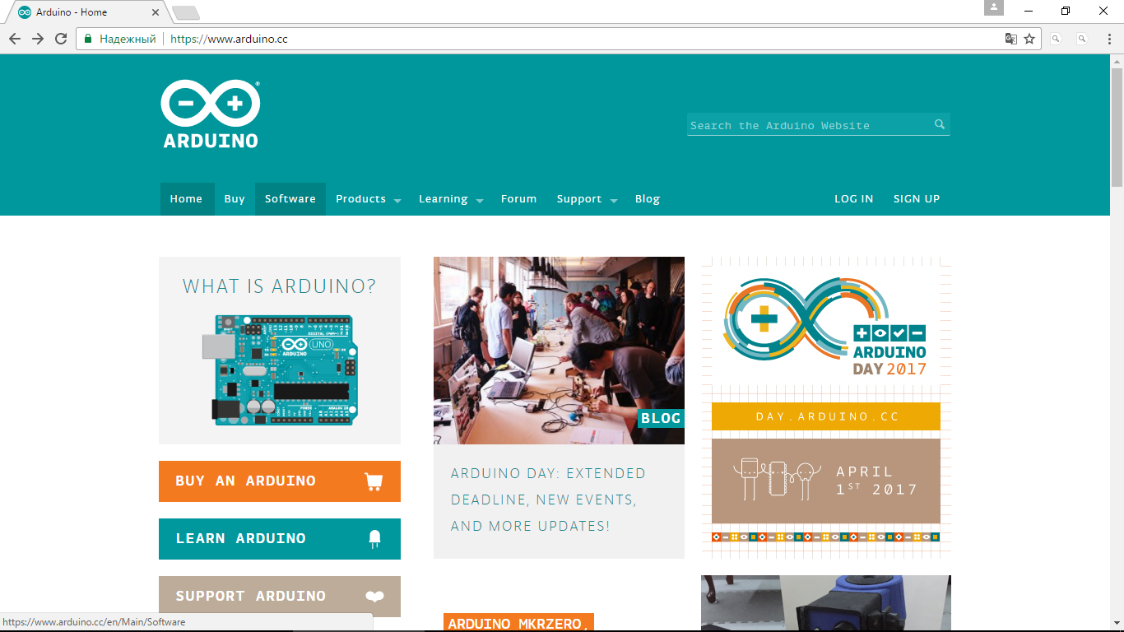
https://www.Arduino.cc

Slide 3
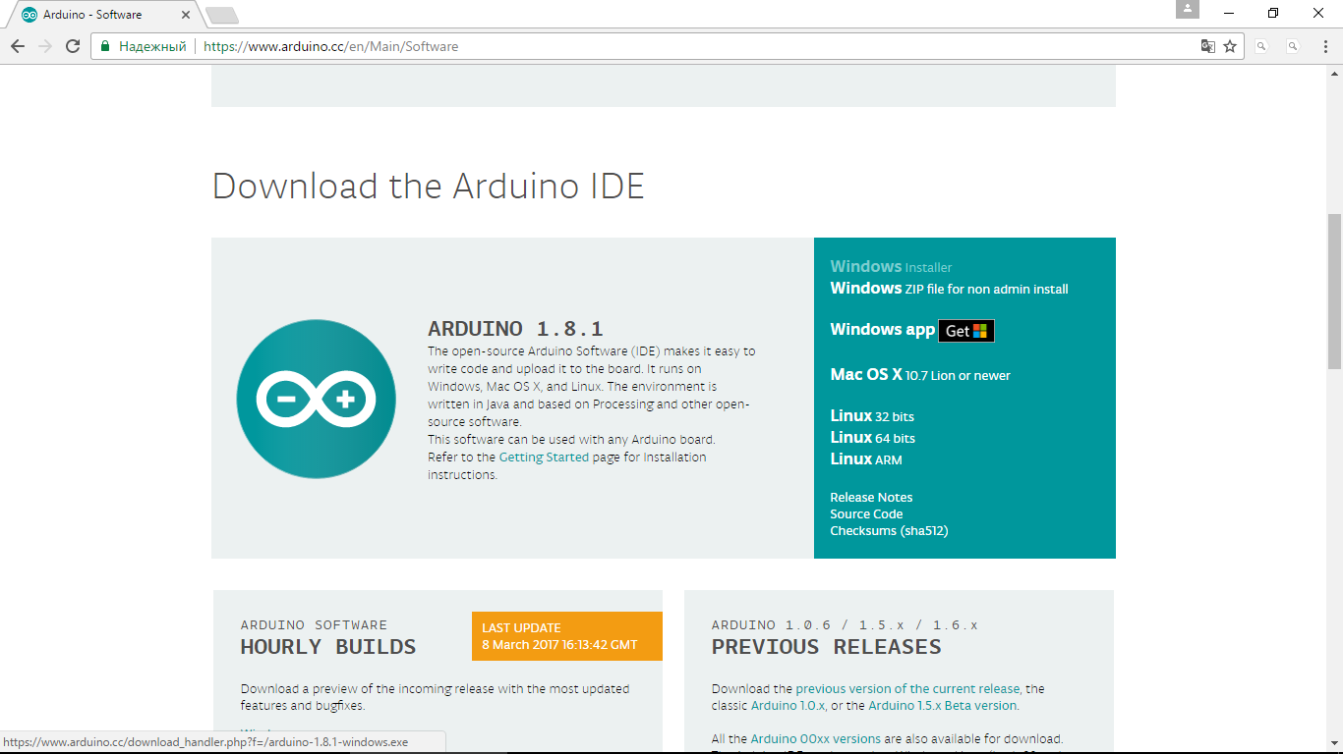
WINDOWS uchun yuklab olish

Slide 4
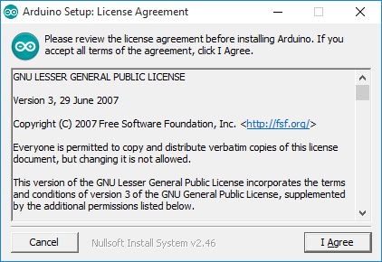
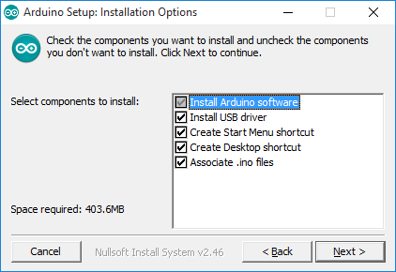
Arduino ide ilovasini o’rnatish bosqichlari:

Slide 5
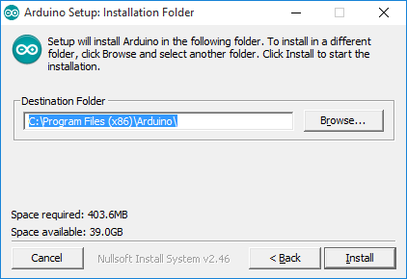
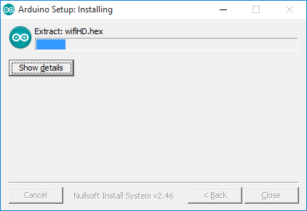

Slide 6
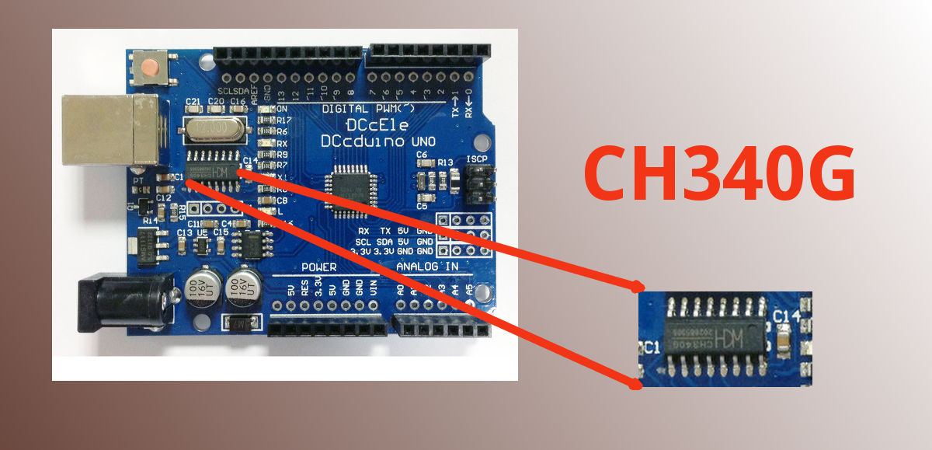
CH340G USB – INTERFACE UCHUN DRIVER O’RNATISH:

Slide 7
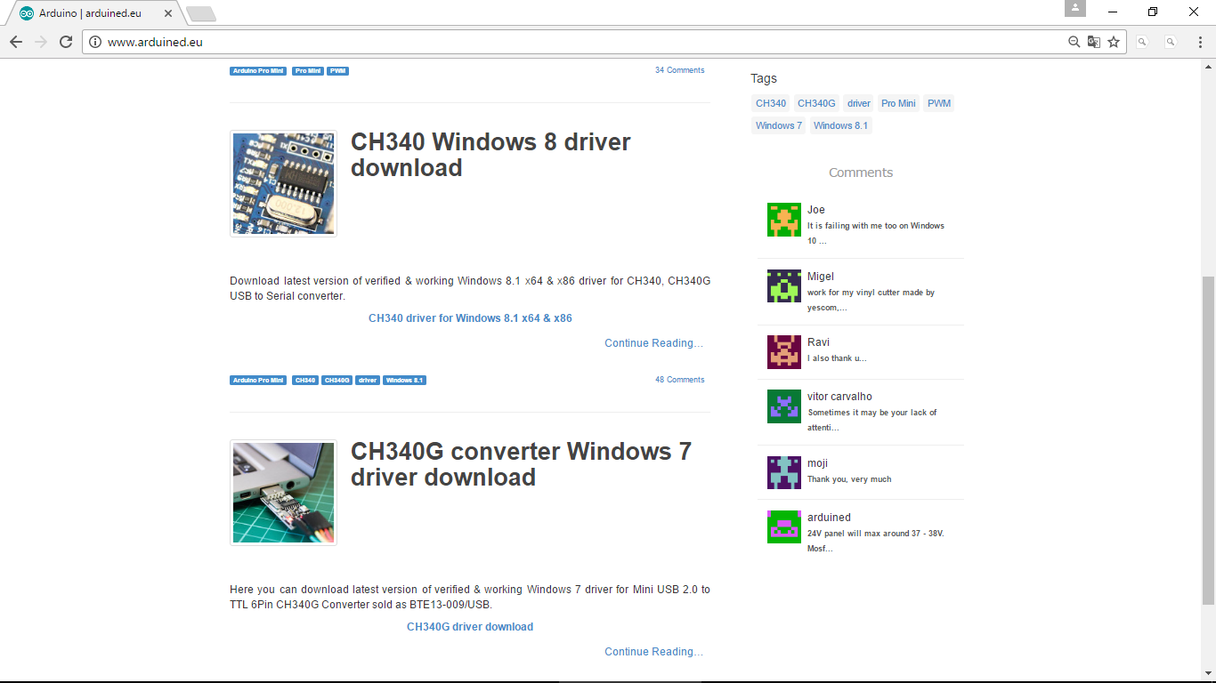
www.arduined.eu
Windows uchun yuklab olish

Slide 8
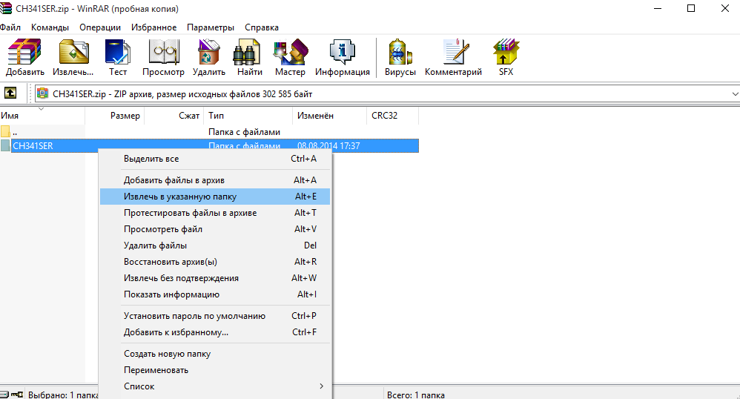

Slide 9
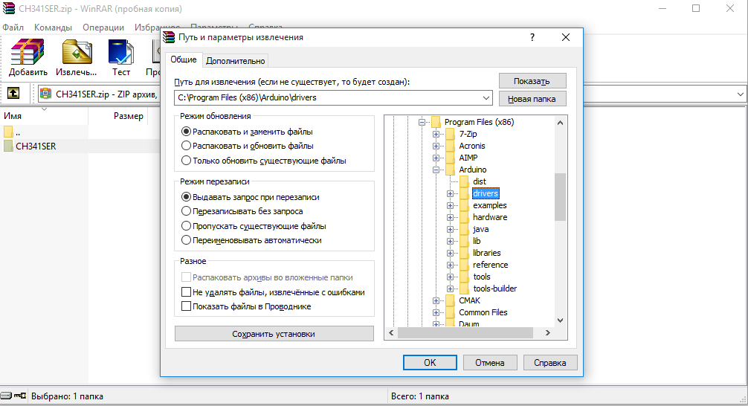
C:\Program Files (x86)\Arduino\drivers

Slide 10
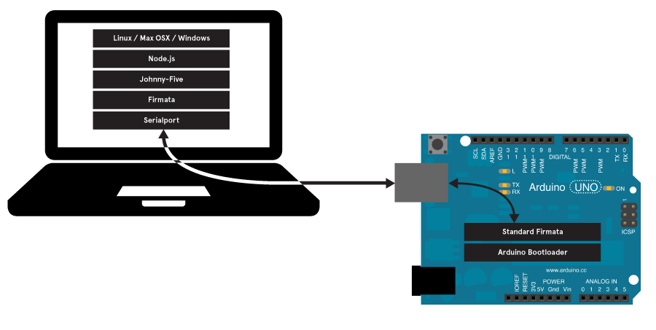
Hammasi tayyor bo’ldi Arduino mikrokontrollerini kompyuterga ulashingiz mumkin.
Kompyuterdan arduino ilovasini ishga tushuring!

Slide 11
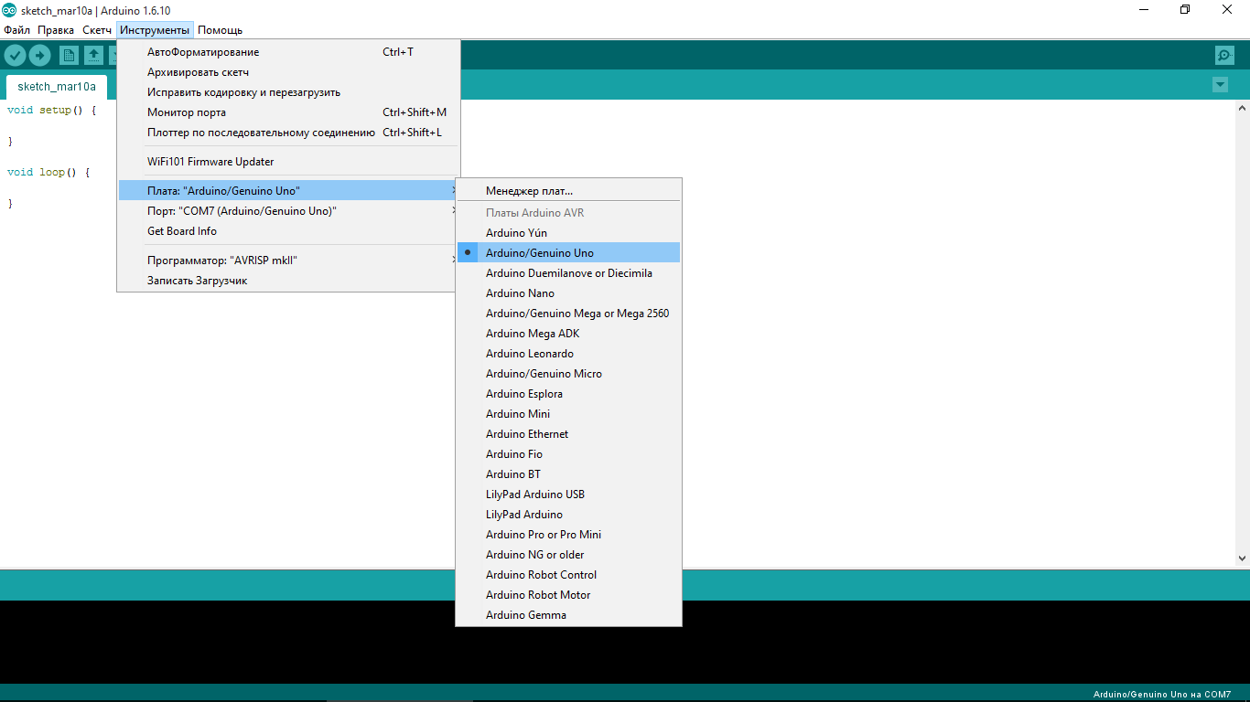
Bu yerda Arduino mikrokontrollerining turi ko’rsatiladi:

Slide 12
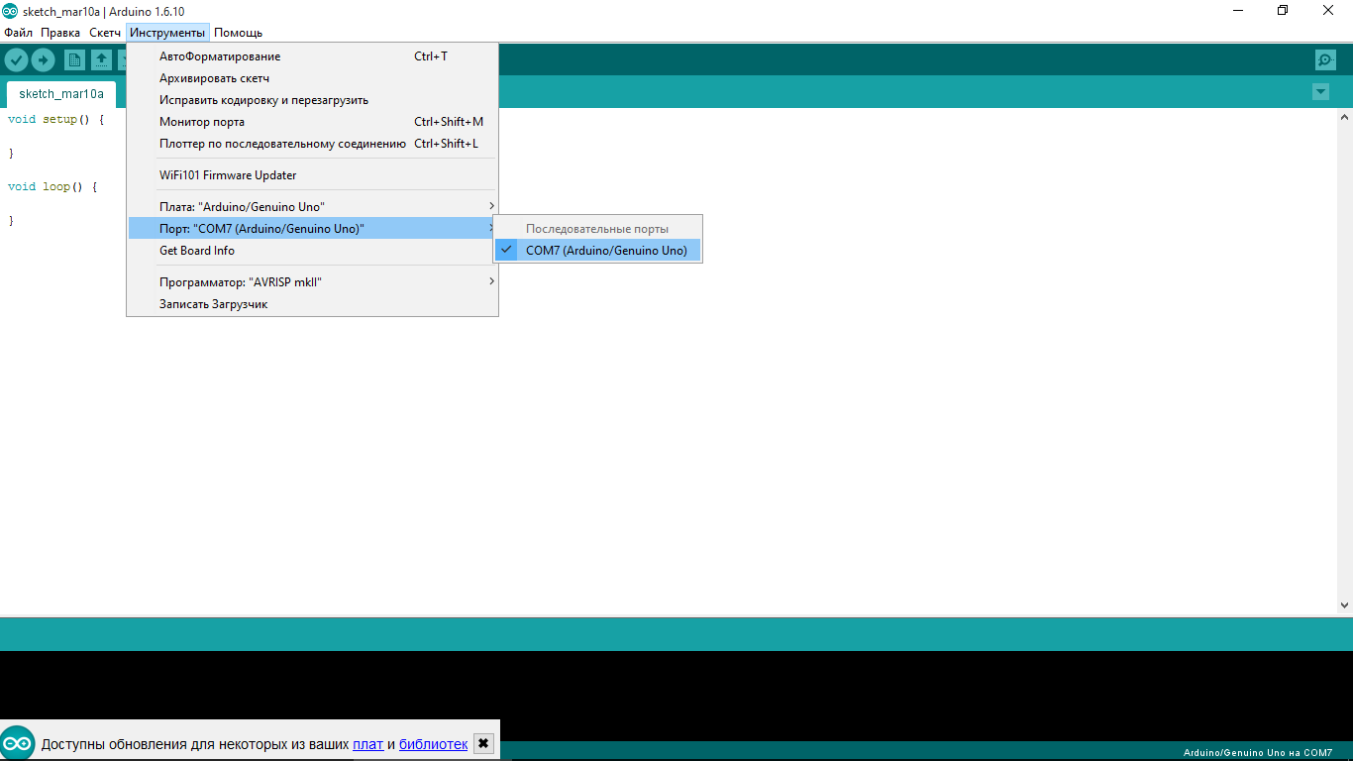
Bu yerda Arduino mikrokontrollerining usb – port turi ko’rsatiladi.

Slide 13
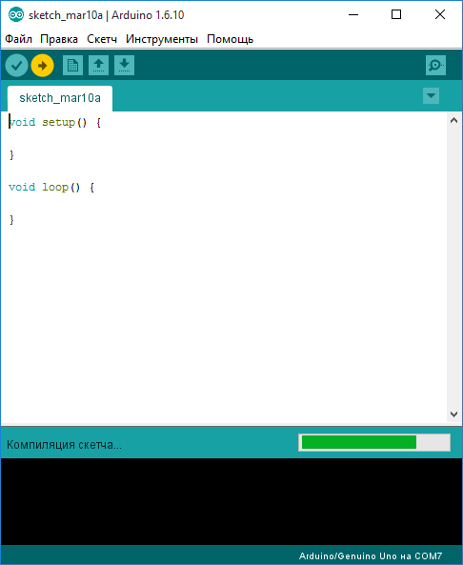
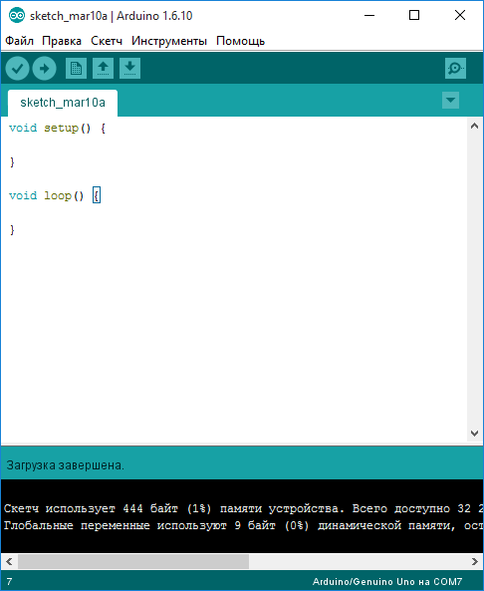
Tekshirish uchun (загрузка) yuklash tugmasi bosib ko’ring.

